Slide 1
BUILDING MATERIALS AND CONCRETE TECHNOLOGY
CONSTITUENTS OF CONCRETE

Slide 2
CONTENTS
CEMENT
CHEMICAL COMPOSITION
CHEMICAL AND PHYSICAL PROCESSES OF HYDERATION
STRUCTURE OF HYDRATED CEMENT
BLENDED CEMENTS
PROPERTIES OF CEMENT AND THEIR EFFECT ON PROPERTIES OF CONCRETE
AGGREGATES
CLASSIFICATION
MECHANICAL, PHYSICAL AND THERMAL PROPRERTIES OF FINE AND COARSE AGGREGATES THAT AFFECT THE PROPERTIES OF CONCRETE
MANUFACTURING SAND
QUALITY OF MIXING WATER

Slide 3
WHAT IS CEMENT?
Cement may be prescribed as a material with adhesive and cohesive properties which make it capable of bonding mineral fragments into a compact whole.

Slide 4
It may be called as Portland cement.
Portland cement is so named because a paste of cement with water, after it sets hard, resembles in colour and hardness a Portland stone, a limestone quarried in Dorset.
It is prepared in different varieties.

Slide 5
PROPERTIES OF CEMENT
1. provides strength to masonry.
2. stiffens or hardens early.
3. possessed good plasticity.
4. An excellent building material.
5. Easily workable.
6. Good moisture-resistant.

Slide 6
USES OF CEMENT
1. It is used in cement mortar for masonry work, plastering, pointing, etc.
2. It is used in making joints for pipes, drains etc.
3. It is used in concrete for laying floors, roofs and construction lintels, beams, stairs, pillars etc.
4. It is employed for manufacturing precast pipes, piles, fencing posts etc.

Slide 7
5. It is used in construction of important engineering structures such as bridges, culverts, dams, tunnels, light housed etc.
6. it is used in the preparation of foundations, water tight floors, footpaths etc.

Slide 8
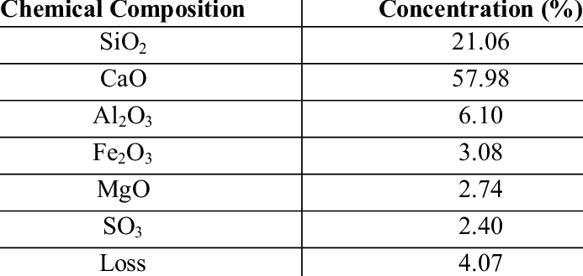
CHEMICAL COMPOSITION OF CEMENT

Slide 9
LIME (CaO)
1. It is the major constituent of cement and its proportion needs to be maintained carefully.
2. the lime in excess makes the cement unsound and causes the cement to expand and disintegrate.
3. If lime is in deficiency, the strength of cement is decreased and cement sets quickly.
4. If lime is in right proportion, it makes the cement sound and strong.

Slide 10
SILICA
1. It is an important ingredient of cement and imparts strength to the cement due to the formation of dicalcium and tricalcium silicates.
2. Silica in excess provides greater strength to the cement but at the same time prolongs its setting time.

Slide 11
ALUMINA
1. It imparts quick setting quality to the cement.
2. It acts as a flux and lowers the clinkering temperature.
3. Alumina in excess reduces the strength of cement.

Slide 12
CALCIUM SULPHATE
1. It is present in the form of gypsum.
2. it helps in increasing the initial setting time of cement.

Slide 13
IRON OXIDE
1. It provides colour, hardness and strength to cement.
2. It also helps in the fusion of raw materials during manufacture of cement.

Slide 14
MAGNESIUM OXIDE
1. This ingredient, if present in small amount, imparts hardness and colour to the cement.
2. Magnesium Oxide in excess makes the cement unsound.

Slide 15
SULPHUR TRIOXIDE
1. If present in very small quantity, it makes the cement sound.
2. If present in excess, it makes the cement to become unsound.

Slide 16
ALKALIES
1. They should be present in small quantities.
2. Alkalies in excess will cause efflorescence.

Slide 17
MANUFACTURE OF OPC Basic steps in the process
Step 1: Constituent materials are finely ground, mixed.
Step 2: The mixture is heated to partial fusion in a kiln at a temperature of about 1450°C.
Step 3: The fused mass is cooled to produce the clinker.
Step 4: The clinker is ground to a very fine powder in ball mills. Gypsum or plaster of Paris (about 3%) is added at this stage.
The finely ground powder so obtained is OPC.

Slide 18
ROLE OF GYPSUM
In the absence of gypsum, the tricalcium aluminate (C3A) in the cement reacts too rapidly with water and hydration products formed render the cement ‘unworkable’.
Thus to regulate the setting process, gypsum is added to the clinker at the time of grinding.

Slide 19
PORTLAND CEMENT
Cement clinker contains four major phases:
1. C3S (Alite: 3CaO + SiO2) : 20 – 50 µm
2. C2S (Belite: 2CaO + SiO2) : 15-20 µm
3. C3A (Aluminate: 3CaO + Al2O3)
4. C4AF (Ferrite: 4CaO + Al2O3 + Fe2O3)
Abbrevation
CaO = C
Al2O3 = A
Fe2O3 = F
SiO2 = S

Slide 20
PROPERTIES OF OPC
Physical properties
Specific gravity
fineness
Consistency
Setting
Initial
final
Strength development
Early
28 days
Ultimate
Soundness
Ignition loss
Alkali content

Slide 21
PROPERTIES OF CEMENT
In a manner of speaking , there is a clear link between the processes of hydration, heat liberation and strength development.
For example, C3A hydrates most rapidly, and liberates the maximum heat, and contributes to the early stiffening of cement. Similarly, C2S hydration is the slowest and produces least heat, and contributes to the ultimate strength to the cement.

Slide 22
PROPERTIES OF CEMENT
This relation between the hydration, liberation of heat and development of strength, is utilized in trying to develop different cements.
For example, low heat cement have a lower C3A content. Or, rapid hardening cements may have a higher C3A.

Slide 23
Factors affecting opc properties
Cement can be characterized by standard consistency, initial and final setting times, strength development, heat liberation, soundness and ignition loss.
Now, basically these are determined by its fineness, and the chemical composition (relative amounts of C3A, C2S, C3S, etc.)

Slide 24
HYDRATION OF CEMENT
The process of reaction of water with the different constituent complexes of cement is called hydration.
The process is exothermic and involves evolution of heat.
The process starts as soon as water comes in contact with cement (in the mixture itself) and continues for several weeks.

Slide 25
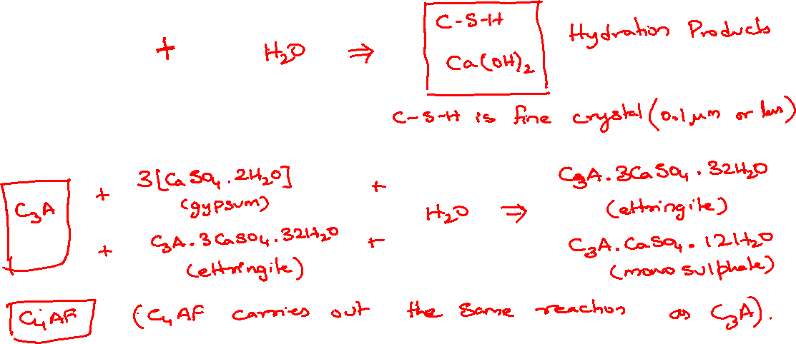
Hydration of Portland Cement
C3S
C2S

Slide 26
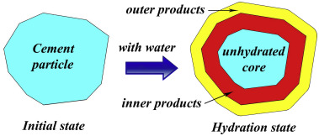
HYDRATION MODEL FOR PORTLAND CEMENT

Slide 27
HYDRATION REACTIONS
C₃S + H₂O = C-S-H + Ca(OH)₂
C₂S + H₂O = C-S-H + Ca(OH)₂
C₃A + H₂O = C₄AH₁₃ + C₂AH₃
C₃A + H₂O = C₃A.3CSH₃₂
C₄AF + H₂O = C₃AFH₆ +CFH

Slide 28
HYDRATION OF EACH MINERAL
C₃S
C₂S
C₃A
C₄AF

Slide 29
HYDRATION OF C₃A
Constitute about 10% of cement
This phase reacts the fastest, and is responsible for the initial setting of cement.
Gypsm is added to the cement essentially to control this reaction
Heat evolution is about 1350 J/g

Slide 30
HYDRATION OF C₃A(ALUMINATE)
The hydration of C₃A within water is very early.
It becomes hard quickly and it becomes impossible to cast.
In case of calcium hydroxide + gypsm, the hydration of C₃A becomes low.

Slide 31
HYDRATION OF C₄AF
Constitutes about 10% of cement, depending upon the quantity of iron in the clay as an impurity.
It is responsible for the grey colour of cement.
Presence of gypsm effects the hydration of the phase also.
Contribute little to the long term strength of the cement, and sets slowly liberating about 420 J/g

Slide 32
HYDRATION OF C₃A, C₄AF
Hydration of C₃A controls the formation of ettringite.
The hydration is again promoted after about 1day.
The hydration of C₄AF is slow.

Slide 33
HYDRATION OF C₂S
Constitutes about 15 – 35% of cement.
Hydrates slowly and is responsible for the ultimate strength in cement.
Hydration of C₂S liberates about 260 J/g of heat.

Slide 34
HYDRATION OF C₃S AND C₂S
The reaction of C₃S is promoted by coexistence of C₂S.
The reaction of C₂S is promoted by C₃S at early age.
The reaction of C₂S is delayed by C₃S at long term age.

Slide 35
C-S-H gel
This is known as calcium-silicate-hydrate get, is loosely referred to as the C-S-H gel because its stoichiometry varies depending upon the CaO to SiO₂ ratio of the cement.
This gel is the most important hydration product of cement from the point of view of strength development.

Slide 36
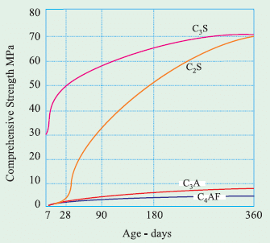
Development of strength of pure compounds

Slide 37
Heat of hydration
When Portland cement is mixed with water, heat is liberated. This heat is called the heat of hydration, the result of the exothermic chemical reaction between cement and water. The heat generated by the cement’s hydration raises the temperature of concrete.

Slide 38
TYPES OF CEMENT
A) Ordinary Portland Cement
- Ordinary Portland Cement 33 Grade – IS 269: 1989
- Ordinary Portland Cement 43 Grade – IS 8112: 1989
- Ordinary Portland Cement 53 Grade – IS 12269: 1987
B) Rapid Hardening Cement – IS 8041: 1990
C) Extra Rapid Hardening Cement

Slide 39
D) Sulphate Resisting Cement – IS 12330: 1988
E) Portland Slag Cement – IS 455: 1989
F) Quick Setting Cement –
G) Super Sulphated Cement – IS 6909: 1990
H) Low Heat Cement – IS 12600: 1989

Slide 40
I) Portland Pozzolana Cement – IS 1489 (Part I) 1991 (fly ash based)
- IS 1489 (Part II) 1991 (Calcined Clay based)
J) Air entraining Cement
K) Coloured Cement: White Cement – IS 8042: 1989
L) Hydrophobic Cement – IS 8043: 1991

Slide 41
M) Masonry Cement – IS 3466: 1988
N) Expansive Cement –
O) Oil Well Cement – IS 8229: 1986
P) Rediset Cement –
Q) OPC 53 grade S – IRS-T 40: 1985

Slide 42
R) High Alumina Cement – IS 6452: 1989
S) Very High Strength Cement -

Slide 43
CONTENTS
CEMENT
CHEMICAL COMPOSITION
CHEMICAL AND PHYSICAL PROCESSES OF HYDERATION
STRUCTURE OF HYDRATED CEMENT
BLENDED CEMENTS
PROPERTIES OF CEMENT AND THEIR EFFECT ON PROPERTIES OF CONCRETE
AGGREGATES
CLASSIFICATION
MECHANICAL, PHYSICAL AND THERMAL PROPRERTIES OF FINE AND COARSE AGGREGATES THAT AFFECT THE PROPERTIES OF CONCRETE
MANUFACTURING SAND
QUALITY OF MIXING WATER

Slide 44
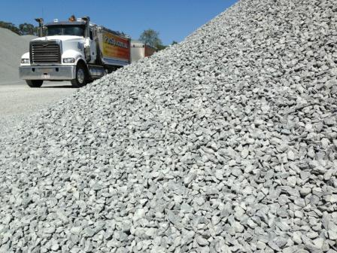
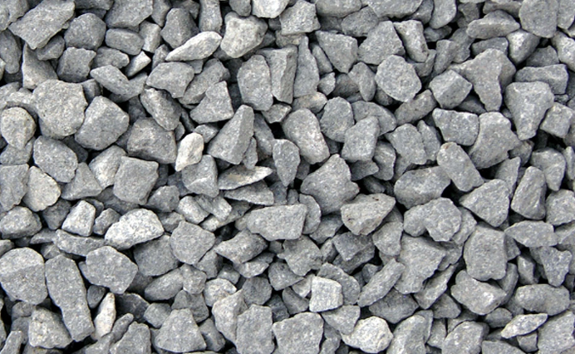
What are Aggregates?
Aggregates are the important constituents in concrete. They give body to concrete, reduce shrinkage and effect economy.

Slide 45
In general aggregates occupy 70 – 80 percent of the volume of concrete.
Cement is the only factory made standard component in concrete. Other ingredients, namely, water and aggregates are natural materials.

Slide 46
Requirements of Good Aggregates
It must be clean.
It should be strong.
It should be durable.
It should not react with cement after mixing.
It should have rough surface.
It should not absorb water more than 5%.
It should not be soft and porous.
It should be chemically inert.
It should be of limiting porosity.
It should be preferably be cubical or spherical in shape.

Slide 47
Classification of Aggregates
According to geological origin
Natural aggregate
Artificial aggregate
According to size
Fine aggregate
Coarse aggregate
According to shape
Rounded aggregates
Irregular aggregates
Angular aggregates
Flaky and elongated aggregates
Based on unit weight
Normal weight
Heavy weight
Light weight

Slide 48
According to geological origin
Natural
Sand, Gravel , Crushed
Rock such as Granite,
Quartzite, Basalt,
Sandstone
Artificial
Broken Brick,
Air-cooled Slag,
Sintered Fly ash,
Bloated Clay

Slide 49
According to the size of the aggregate
Based on the size of aggregate they are classified into two types:
i. Fine aggregate
ii. Coarse aggregate

Slide 50
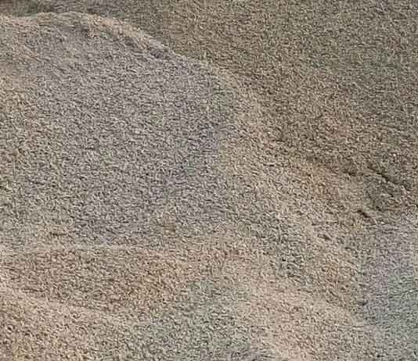
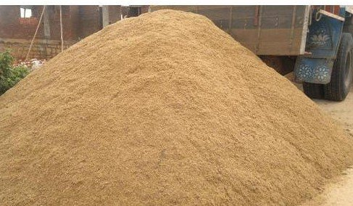
Fine Aggregate
The aggregate which passes through 4.75 mm sieve and retained on 75 micron sieve are known as fine aggregate.

Slide 51
Coarse Aggregate
The aggregate retained on 4.75mm IS sieve are known as coarse aggregate.

Slide 52
Coarse aggregate
Course aggregate basic material of the concrete. Crushed stone or gravel used in concrete are called coarse aggregate and it will not, pass when it is dry through a sieve with ¼-inch-diameter.

Slide 53
CLASSIFICATION ACCORDING TO SHAPE
The aggregate may be classified as:
1. Rounded
2. Irregular
3. Angular
4. Flaky.

Slide 54
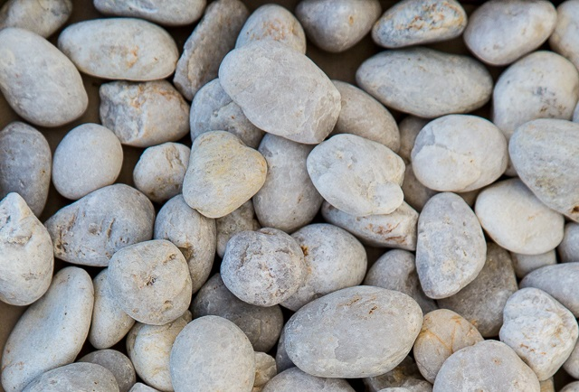
Round shape
The aggregate with rounded particles(river or seashore gravel) has minimum voids ranging 32 to 33%. The only disadvantage is that interlocking between its particles is less and hence the development of bond is poor, making it unsuitable for high strength concrete and pavement.

Slide 55
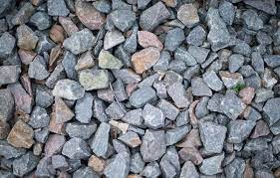
Irregular aggregate
The aggregate having partly rounded particles (pit sand and gravel) has higher of voids ranging from 35 to 38%. It required more cement paste for a given workability.

Slide 56
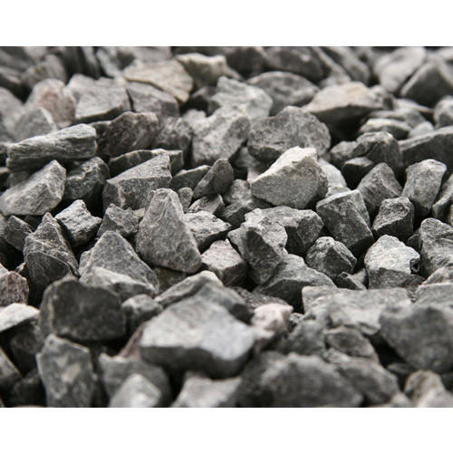
Angular aggregate
The aggregate with sharp, angular and rough particles(crushed rocks) has a maximum of voids ranging from 38 to 40%. The interlocking between the particles is good.

Slide 57
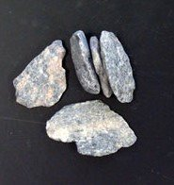
Flaky Aggregate
An aggregate is termed flaky when its least dimension(thickness) is less than3/5th of its mean dimension. The presence of these particles should be restricted to 10 to 15%.

Slide 58
CLASSIFICATION BASED ON UNIT WEIGHT
1. Normal weight Aggregate
2. Heavyweight Or High-density Aggregate
3. Light Weight Aggregate

Slide 59
Normal weight Aggregate:
Crushed stone, gravel and ordinary sand are examples of normal weight aggregate.
They are commonly used in manufacture of normal weight concrete, asphalt concrete and road sub-base.
The average values of specific gravity for sand and gravel are 2.6 and 2.65 respectively. Bulk density of normal weight aggregate is around 1520 to 1680 kg/m³

Slide 60
Heavyweight Or High-density Aggregate
Those aggregates with high density and is used primarily in the manufacture of heavyweight concrete, employed for protection against nuclear radiation and as bomb shelter.
The unit weight of heavy weight concrete varies from 2400 kg/m3 with specific gravity range from 4.0 to 4.6 (eg. Mineral ores and barite)

Slide 61
Light Weight Aggregate
lightweight aggregate has a bulk density less than 1120 kg/m3 for fine aggregate and less than 880 kg/m3 for coarse aggregate.
they are commonly used as ingredients in the manufacture of lightweight concrete, for making lightweight masonry blocks (to improve their thermal and insulating properties and nailing characteristics).

Slide 62
PROPERTIES OF THE FINE AGGREGATE
1. Size: The largest size which may under the range of the fine aggregate is 4.75mm. Using the largest size will give a more dense concrete, but a mixture of all sizes is more desirable and more economical.
2. Shape: Shape of aggregate plays an important role in coarse aggregate rather than fine aggregate.
3. Strength: The strength of aggregate alone cannot ensure strength of concrete. Strength of coarse aggregate is more important.

Slide 63
4. Surface Texture: Generally, rough surface aggregate is preferable to smooth aggregates. This property is also related with coarse aggregate.
5. Specific Gravity: Specific gravity of aggregate is the ratio of its density to the density of water.
6. Bulk Density: This refers to the density of aggregate considered along with volume of voids or empty spaces between the particles. The density of sand falls between 17 to 25 KN/m3.

Slide 64
7. Water Absorption: Generally, for sand, water absorption is negligible, it is desirable that water absorption should be kept minimum.
8. Soundness: This refers to expansion and contraction of the aggregate when subjected to temperature variation.

Slide 65
PROPERTIES OF COARSE AGGREGATE
1. Size: This size of coarse aggregate depends on the used to which the concrete is to be pull. For mass concreting works without complicated reinforcement, larger aggregates of 80 mm, 40 mm, 20 mm sizes are used.
2. Shape: The shape of aggregate is an important characteristic as it affects the workability of concrete. It also affects the strength.

Slide 66
3. Surface Texture: It is the property of coarse aggregate deals with roughness and smoothness of aggregate. Rounded aggregate with smooth surface will require less cement paste and hence increase the yield per bag.
4. Water Absorption: some of the aggregate water absorb and porous. Hence, it affect the water cement ratio and the workability of concrete. The porosity of aggregate also affect if durability of concrete.

Slide 67
5. Soundness: Soundness refer to expansion and contraction of the aggregate. When subjected to temperature various. A good aggregate is that which shows minimum expansion and contraction
6. Specific Gravity: It is the ratio of dry weight of aggregate to the weight of equal volume of water.
7. Bulk Density: The ratio of net weight of aggregate to the volume of aggregate gives bulk density.

Slide 68
CHARACTERISTICS OF AGGREGATES
Important characteristics of aggregates which influences the properties of resulting concrete mix are discussed as under:
- Aggregates containing the constitutes which generally react with alkalis in cement cause excessive expansion, cracking of concrete mix, should never be used. Suitability of aggregates should be judged either by studying its service history or by laboratory tests.

Slide 69
- The size and shape of the aggregate particles mainly influence the quantity of cement required in a concrete mix and ultimately economy of the concrete. For the preparation of economical concrete, one should use largest coarse aggregates feasible for the structure.
- Type of structure Max. size of aggregate
1. Mass concrete work i.e. dams, retaining 40 mm
Walls, piers and abutments, etc.
2. R.C.C work i.e. beams, columns, etc. 20 mm
3. Flooring 10 mm

Slide 70
PROPERTIES
STRENGTH
PARTICLE SHAPE
SPECIFIC GRAVITY
BULK DENSITY
VOIDS
POROSITY
MOISTURE CONTENT

Slide 71
STRENGTH
Should be equal to that of concrete.
Rocks commonly used as aggregates have a higher compressive strength.
Tests conducted for evaluation of strength are crushing, impact and ten % fines test.
Crushing test is more reliable.
Toughness by impact test.
Hardness by abrasion test.

Slide 72
SHAPE & TEXTURE
Shape influences the properties of fresh concrete more than hardened concrete.
Round & irregular aggregates are highly workable but yield low strength.
Flaky aggregates require more cement paste, produce maximum voids.
Angular shape is best.
Shape & texture governs water requirement.

Slide 73
SPECIFIC GRAVITY
SG lies between 2.6 – 2.8 for natural aggregates.
Influences strength and absorption of concrete.
Low SG high porosity and therefore poor durability and low strength.
Density greatly depends upon specific gravity.

Slide 74
BULK DENSITY & VOIDS
Depends upon particle size, grading and moisture content.
A higher bulk density of coarse aggregate is an indication of fewer voids to be filled by sand and cement.
If the voids are more in the concrete, the strength will be low.

Slide 75
POROSITY
The entrapped air bubbles in the rocks during their formation lead to minute holes called as pores or cavities.
The porosity of rocks is less than 20%.
The concrete becomes permeable and effects bond.
The porous aggregate absorbs more moisture, resulting in loss of workability.

Slide 76
MOISTURE CONTENT
A high moisture content increases the W/C ratio to an appreciable extent.
The surface moisture expressed as a % of the weight of the saturated dry aggregate as known as moisture content.

Slide 77
DELETERIOUS MATERIALS & ORGANIC IMPURITIES
Organic matters, clay, shale, coal, iron pyrites, etc., may have harmful or chemical effects on the aggregates.
Affects the properties oof concrete and are undesirable.
Salts cause efflorescence.
Sulphides cause surface staining.

Slide 78
ALKALI AGGREGATE REACTION
Inert material till 1940.
Extensive expansion and complete disruption and disintegration of the concrete is known as alkali aggregate reaction or concrete cancer.
The trouble is due to reaction between silica in aggregate and alkalis in cement.
A reactive aggregate, if in finely ground state will inhibit the action.
Reaction between cement and aggregate can be of two types:- alkalis with either silicas or carbonates in the aggregate.
Reaction with silicas in common.

Slide 79
The AAR takes place only in presence of water or water vapour.
The water forms strong caustic solute with alkalis of cement.
This caustic liquid attacks reactive silica to form silica gel(AAR GEL) of unlimited swelling type.

Slide 80
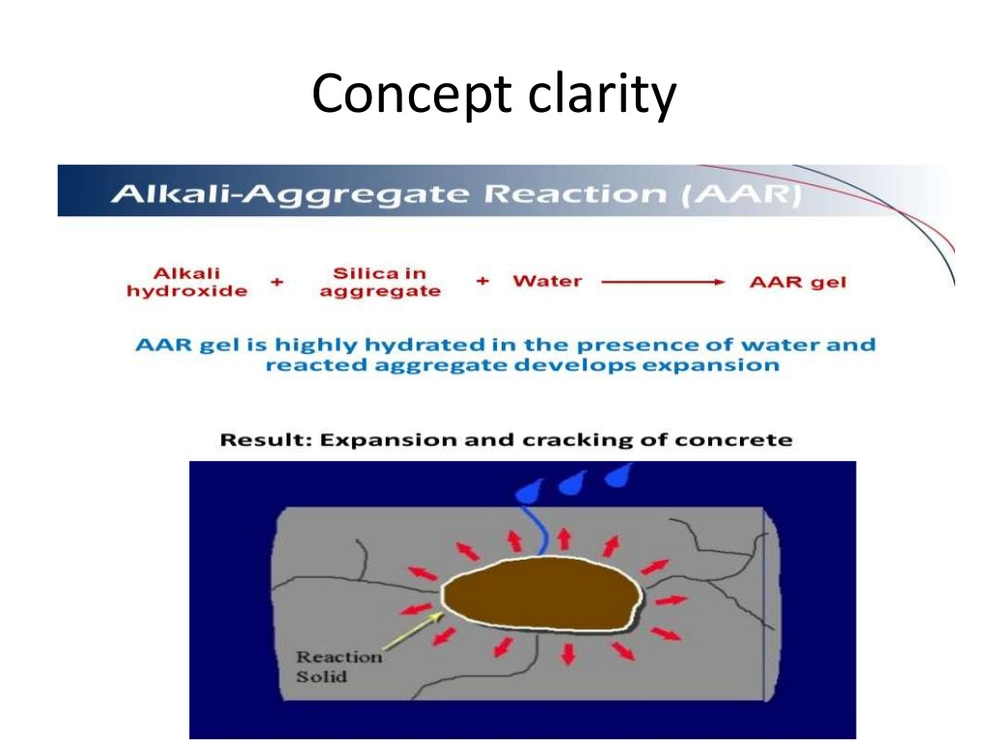

Slide 81
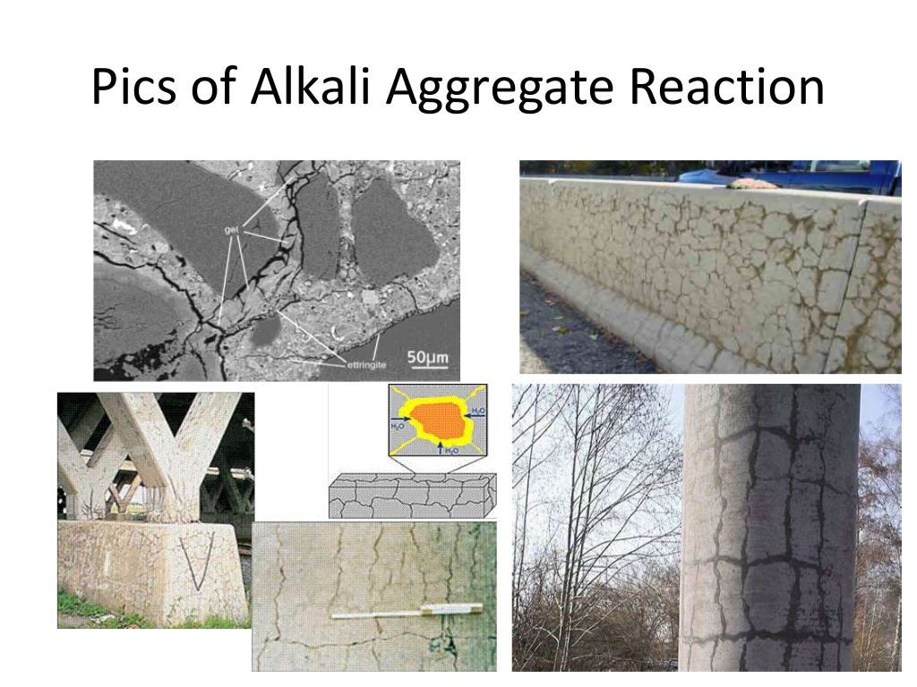

Slide 82
FACTORS AFFECTING ALKALI AGGREGATE REACTION
Reactive type of aggregate[REACTIVE SILICA], have been found to have serious effects IF PRESENT IN SMALL QUANTITIES BUT NOT if it constitutes the whole of aggregate.
High alkali content of cement. If there is very small amount of alkalis in cement and very reactive silica it is not a problem, however the increase in alkali content[>0.6%] of cement posses issues of AAR.
Availability of Moisture Content. AAR occurs ONLY in the presence of moisture, which is the reason why AAR is NOT observed in the interion mass of concrete.
Temperature Conditions should be favourable, generally in the range of 10 to 38 degree C.

Slide 83
Control of Alkali Aggregate Reaction
By selection non-reactive aggregate.
By using Low Alkali Cement.
By controlling Moisture Content.
By using Pozzolana's [REACTIVE SILICA] - The aggregates are found to be reactive when they contain silica in a particular proportion and fineness. When fly-ash or surkhi or dust is added this optimum condition of silica being in particular proportion and fineness is distributed and the aggregates become positive.
By adding air-entraining agents.
- Alkali silica gel which imparts pressure over the set cement gel, can be negated with the addition of air entraining agents which absorb the osmotic pressure.

Slide 84
SOUNDNESS
Soundness is defined as the ability of aggregate to resist changes in volume as a result of changes in physical conditions.
The conditions like freezing changes, alternate wetting and drying.
Porous and weak aggregates undergo excessive volume changes under these conditions.

Slide 85
THERMAL PROPERTIES
The coefficient of thermal expansion of concrete increase with that of coarse aggregate.
Any difference in the coefficients of coarse aggregate and cement paste may break the bond between the two.

Slide 86
FINENESS MODULUS (F.M)
It is numerical index of fineness, giving some idea about the mean size of the particles in aggregates.
The sum of cumulative percentage of residues retained on each of the Indian Standard Sieves(80m, 40mm, 20mm, 10,, 2.36mm, 1.18mm, 600microns, 300 microns and 150 microns each succeeding sieve has half the aperture of the previous one), divided by the 100, is known as “FINENESS MODULUS” of the aggregates.

Slide 87
The fineness modulus of an aggregate is roughly proportional to the average size of particles of the aggregates.
The F.M. varies between 2 to 3.2 for fine aggregate, between 5.5 to 8 for coarse aggregate and between 3.5 to 6.5 for all in aggregate.
The objective of finding F.M. is to grade the given aggregate for the required strength and workability of concrete mix with minimum cement.
Higher the F.M. aggregate result in harsh concrete mixes and lower F.M. results in uneconomical concrete mixes.

Slide 88
TESTS ON AGGREGATE
PARTICLE SIZE
FLAKNESS & ELONGATION INDEX
MOISTURE CONTENT
SPECIFIC GRAVITY AND WATER ABSORPTION
AGGREGATE CRUSHING VALUE
AGGREGATE IMPACT VALUE
AGGREGATE ABRASION VALUE

Slide 89
PARTICLE SIZE
Sieve analysis is also called as Particle size value. In determination of the proportions of the particles with in certain ranges in an aggregate by separation on various sieves of different size opening, may be defines as sieve analysis.
FINENESS MODULUD = cumulative% of agg retained on each sieve/100

Slide 90
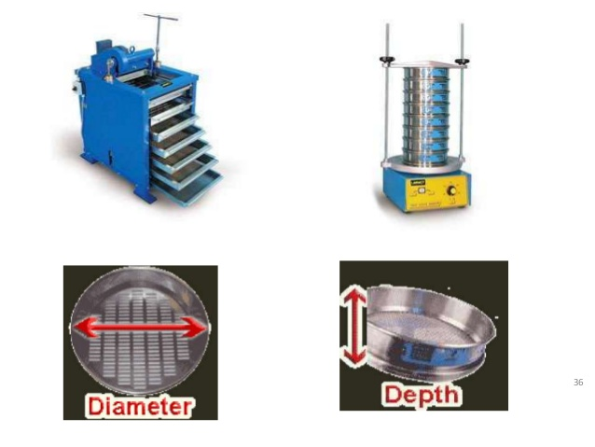

Slide 91
FLAKINESS & ELONGATION INDEX
Large number of flaky particles -> more voids -> more mortar to fill voids -> un economy -> effects durability.
Aggregates may break down easily under heavy loads.
Also called shape test.
I.S. 2836 part-1.

Slide 92
TEST
Apparatus required:-
Aggregate sample
Digital balance
Elongation gauge & Thickness gauge
Test sieves of sizes - 63mm, 50mm, 40mm, 31.5mm, 25mm, 20mm, 16mm, 12.5mm an 10mm & 6.3mm.

Slide 93
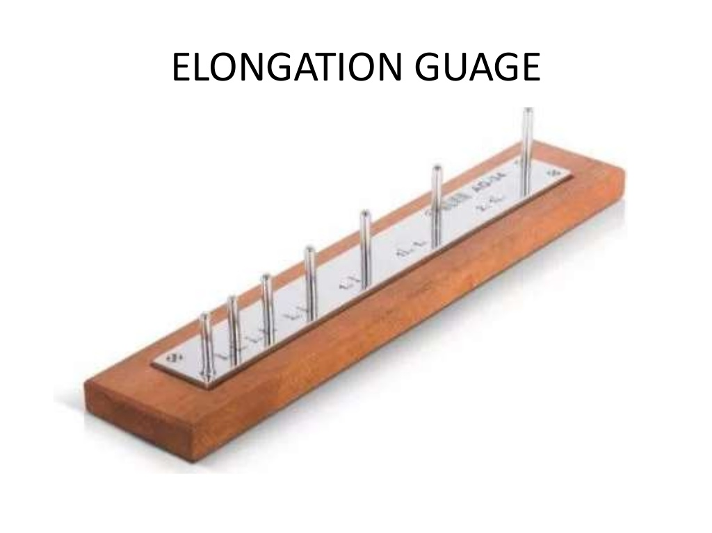

Slide 94
PROCEDURE
Take the aggregate sample which contains minimum 200 pieces of any fraction.
Sieve the sample through mentioned sieves i.e., from 63mm to 6.3mm sieves.
The aggregate retained on 63mm and passed through 6.3mm should not be considered.
The aggregate passed through 63mm and retained on 6.3mm and its above sieves is taken along with sieves. Now we have specified size range of every particle.
Now weigh aggregate retained on different sieve and note down the total weight as “ W1 ”.

Slide 95
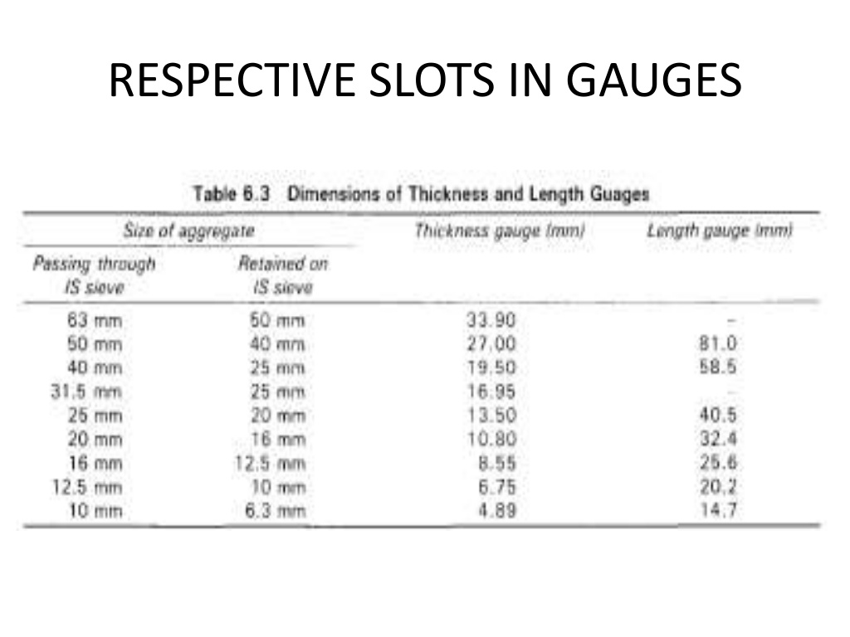

Slide 96
For determining F.I., the aggregate retained on sieves are separated.
Now each aggregate is passed through the corresponding slot in the thickness gauge.
F.I. = (W1/W2) * 100
- Where, W1 is weight of aggregate passing through the slot of thickness gauge.
- W2 is the total weight of sample.

Slide 97
For determining E.I., the aggregate retained on sieves are separated.
Then each aggregate piece is passed through the corresponding slot of length gauge.
E.I. = (W1/W2) * 100
- Where, W1 is the weight of aggregate on length gauge.
- W2 is the total weight of aggregate.

Slide 98
MOISTURE CONTENT
A sample of 2kg of aggregate is used for conducting the test.
The sample should be thoroughly washed to remove finer particles, dust etc., & then placed in wire basket and immersed in distilled water at room temperature for a period of 24hrs.
Then the aggregates are removed Y& gently surface dried with a dry cloth and weighed.

Slide 99
The aggregates are then placed in an oven at a temperature of 100 to 110 degree C for 24hrs.
After 24 hrs, aggregates are removed and cooled in air tight container and weighed.
Water Absorption = (W1/W2) * 100
- W1 is weight in gm of the surface dry aggregate.
- W2 is weight in gm of oven dried aggregate.
Water absorption shall not exceed 2%

Slide 100
SPECIFIC GRAVITY
Sp.Gr = (Weight of Agg.(WA)) / (Weight of an equal volume of water(VA * Pw)
= WA / ( VA * PW)
=PA / PW
Where, PA is the density of aggregate
Pw is the density of water
Sp.Gr. Is used in certain computations for concrete mix design or control work, such as, absolute volume of aggregate in concrete. It is not a measure of the quality of aggregate.

Slide 101
AGGRGATE IMPACT VALUE TEST
The aggregate impact value gives a relative measure of the resistance of an aggregate to sudden shock or impact.
The property of a material to resist impact is known as toughness. Due to movement of vehicles on the road the aggregates are subjected to impact resulting in their breaking down into smaller pieces.
The aggregates should therefore have sufficient toughness to resist their designation due to impact. This characteristic is measured by impact value test. The aggregate impact value is a measure of resistance to sudden impact or shock, which may differ from its resistance to gradually applied compressive load.

Slide 102
APPARATUS
The apparatus as per IS: 2386 (Part IV) – 1936 consists of:
A testing machine weighing 45 to 60 kg and having a metal base with a painted lower surface of not less than 30 cm in diameter. It is supported on level and plane concrete floor of minimum 45 cm thickness. The machine should also have provisions for fixing its base.
A cylindrical steel cup of internal diameter 102 mm, depth 50 mm and minimum thickness 6.3 mm.
A metal hammer or tup weighing 13.5 to 14.0 kg the lower end being cylindrical in shape, 50 mm long, 100.0 mm in diameter, with a 2 mm chamfer at the lower edge and case hardened. The hammer should slide freely between vertical guides and be concentric with the cup. Free fall of hammer should be within 380 + 5 mm or 380 - 5 mm.
A cylindrical metal measure having internal diameter 75 mm and depth 50 mm for measuring aggregates.
Tamping rod 10 mm in diameter and 230 mm long, rounded at one end.
A balance of capacity not less than 500 g, readable and accurate up to 0.1 g.

Slide 103
